Slide 1
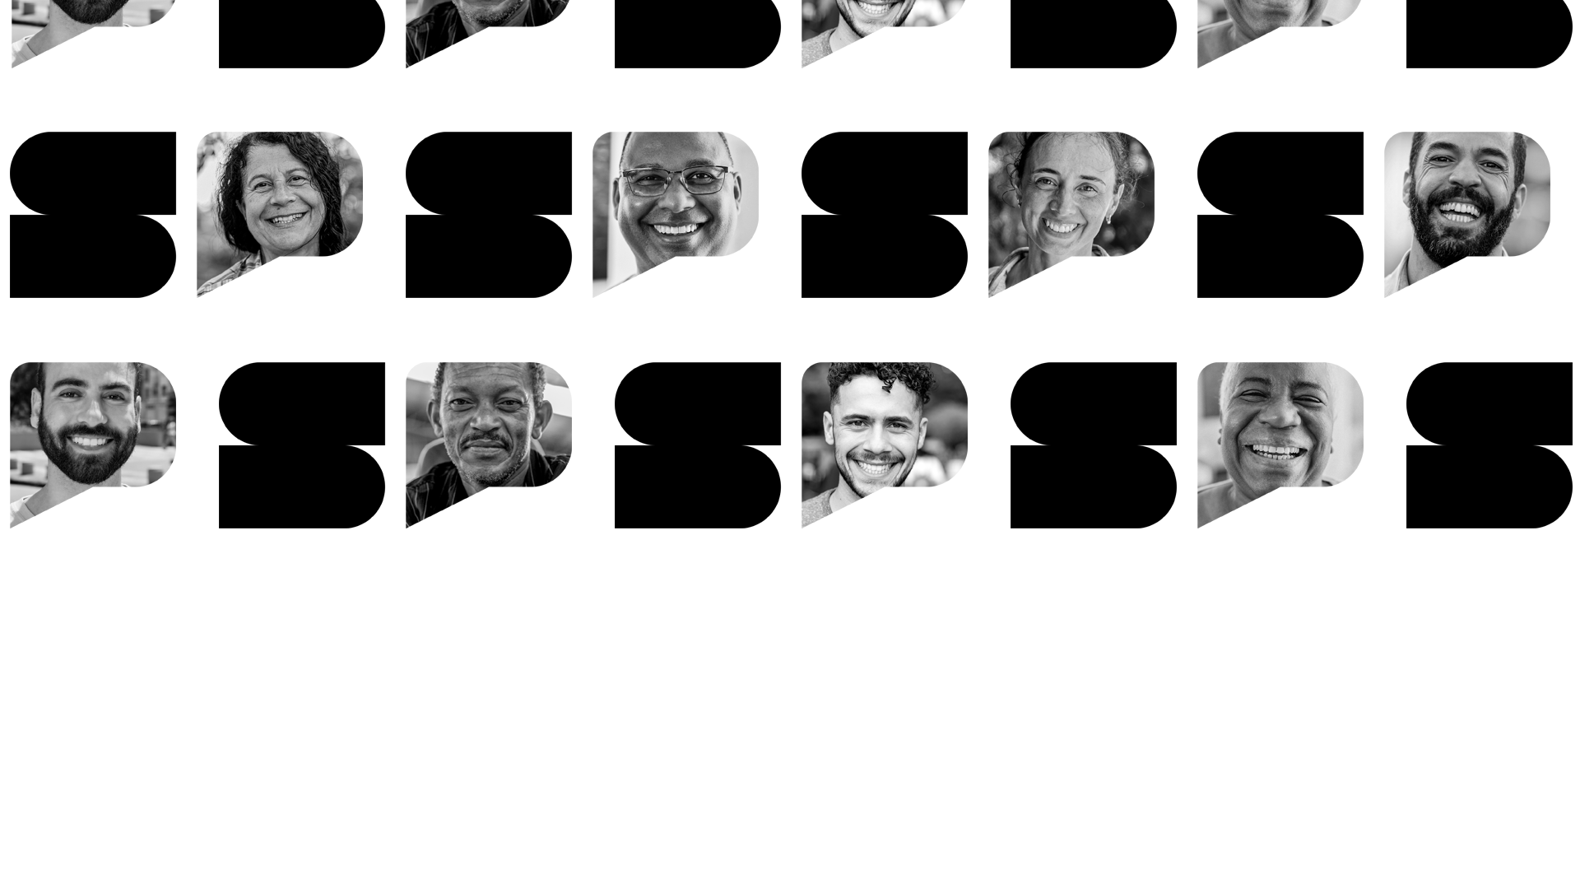



M.E.R.LIN : Assistive System for Enhancing Computer Use by People with Motor Disabilities.
English Pitch : 19/11/2025

Slide 2


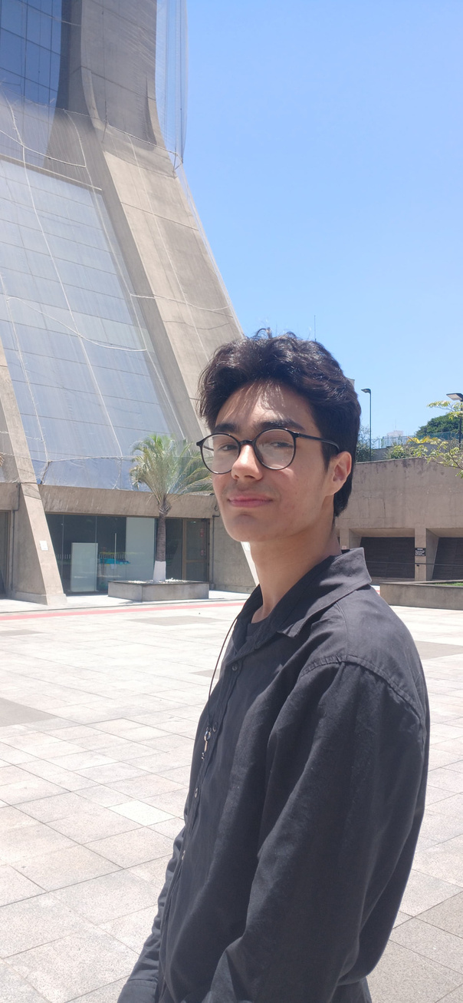



GOVERNMENT OF THE STATE OF SÃO PAULO
Members
EMILY
CRISTINA
RODRIGO
LIMA
JOÃO
MOTA

Slide 3


GOVERNMENT OF THE STATE OF SÃO PAULO
THEME
Assistive software that helps people with motor disabilities including Ataxia, Myopathies, EDS, and amputations enter the workforce using facial movement-based control interfaces.
(Logo)
Source : Self-developed, 2025.

Slide 4


GOVERNMENT OF THE STATE OF SÃO PAULO
JUSTIFICATION
“Society and even families often reinforce the stigma that people with disabilities cannot act independently” (MOREIRA et al., 2015, apud RODRIGUES; PEREIRA, 2021, p. 9).
“People with disabilities can work if given proper support” (SOUSA, 2000, apud RODRIGUES; PEREIRA, 2021, p. 15).
People with disabilities experience social interactions intensely, linked to belonging and work recognition (LIMA, 2013).
Source : PCD+, 2025.

Slide 5
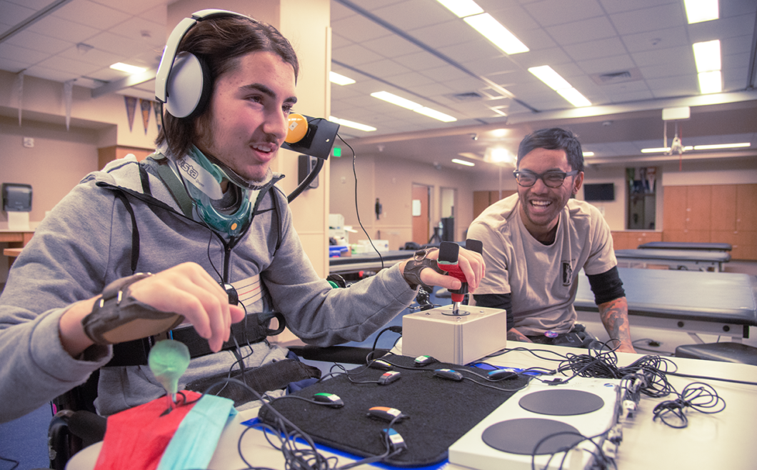

GOVERNMENT OF THE STATE OF SÃO PAULO
GENERAL AND SPECIFIC OBJECTIVES
Develop assistive software that uses the camera and OS to execute functions via a visual interface.
Structure M.E.R.LIN with accessible, features to assist computer navigation for people with motor desabilities.
Enhance M.E.R.LIN to enable additional layers of accessible computer navigation.
Study the benefits of assistive software for people with motor disabilities.
Source : Xbox/Microsoft, 2025.

Slide 6

GOVERNMENT OF THE STATE OF SÃO PAULO
METHODOLOGY
“Quantitative methodology seeks to quantify data and use it in statistical analyses.” (MARCONI; LAKATOS, 2017, p. 124)
Source : Canva, 2025.

Slide 7





GOVERNMENT OF THE STATE OF SÃO PAULO
TECHNOLOGIES
Python
MediaPipe
CustomTkinter
Shell Script
This is what brings M.E.R.LIN to life
The bridge between wanting to act and taking action
The friendly face of the system
The engineer behind the scenes

Slide 8
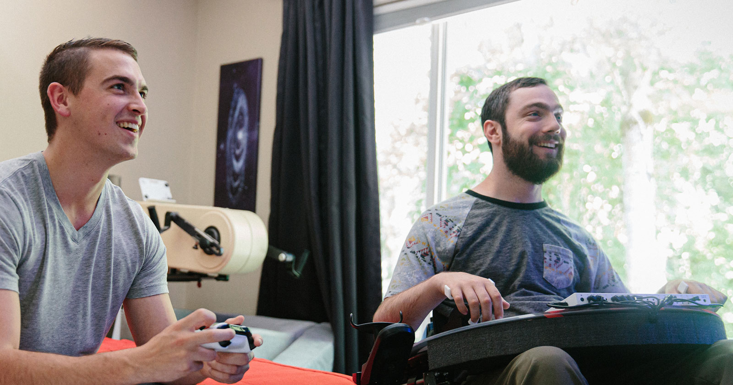
GOVERNMENT OF THE STATE OF SÃO PAULO
EXPECTED RESULTS
Capable to promote inclusion
The software will allow essential tasks
It also provides a customizable and intuitive interface
Source : Xbox/Microsoft, 2025.

Slide 9
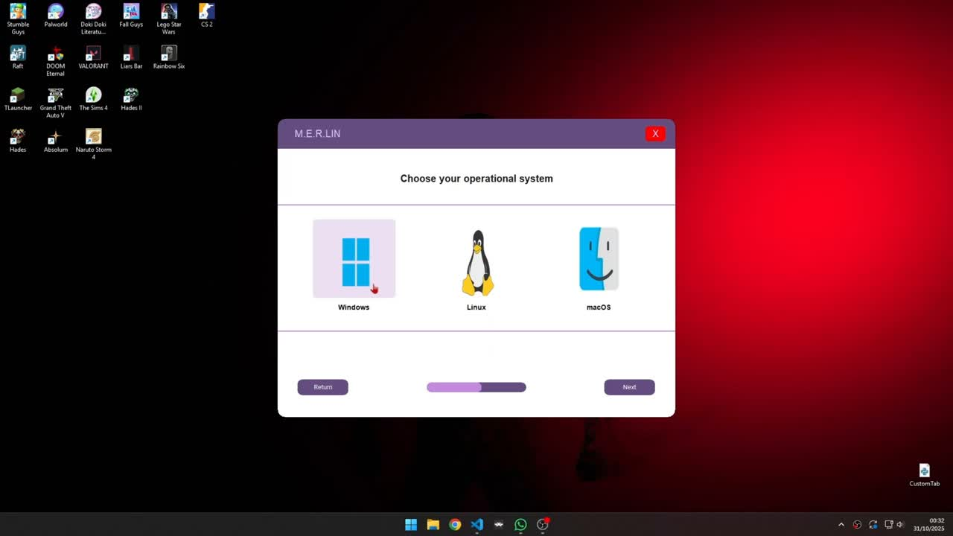
GOVERNMENT OF THE STATE OF SÃO PAULO
OBJECT DEMONSTRATION

Slide 10

OUR WEBSITE
IT'S NOT OVER YET
We invite you to know more about our project!

Slide 11
GOVERNMENT OF THE STATE OF SÃO PAULO
REFERENCES
RODRIGUES, P. S.; PEREIRA, E. L. A Percepção das Pessoas com Deficiência Sobre o Trabalho e a Lei de Cotas: Uma Revisão da Literatura, v.31, p, . 15 nov. 2021.
MARCONI, M. A.; LAKATOS, E. M. Fundamentos de Metodologia Científica. 8. ed. São Paulo: Atlas, 2017.

Slide 12
M.E.R.LIN : The Vision of Acessibility
THANKS SO MUCH FOR YOUR TIME !

